Slide 1
OpenMP
SET10108 Concurrent and Parallel Systems

Slide 2
Breakdown
Parallel Application Design Considerations
OpenMP
Working with Variables
Parallel For
Dividing Work
Other Useful OpenMP Functions

Slide 3
Design Considerations

Slide 4
Design Patterns
You might notice a pattern in how we have designed our parallel applications up until now
Discover how many threads
Discover amount of work to be done
Split work amongst threads
Wait for result
Almost every parallel problem we have looked at thus far follows this model
We have discussed task parallelism – but really our problems have been data parallel

Slide 5
Data Parallelism
Data parallel problems are sometimes referred to as “embarrassingly parallel”
In other words they are simple to parallelise
A problem that the data can be processed individually is considered to be a data parallel problem
Graphics rendering using polygons is considered data parallel
Many data streaming problems are considered data parallel
Data parallelism problems are generally easy to deal with – we just need to understand how to divide the work
SIMD (Single-Instruction Multiple-Data) is the key here

Slide 6
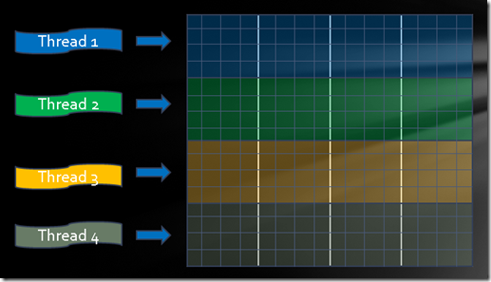
Simple Solutions
What we need are some simple solutions to utilise data parallelism
Rather than typing many lines of code – have some method of describing a part that can be parallelised
Many frameworks that can do this
OpenMP
Intel Thread Building Blocks
etc.

Slide 7
OpenMP

Slide 8
What is OpenMP?
OpenMP is a library to support shared memory concurrency
The MP part stands for multiprocessing
This means that it is not too far removed from what we are already doing
Threads are being created
Threads can potentially access any part of computers memory
OpenMP has a quite universal support amongst C++ compilers
Portable code
It is often used in conjunction with other approaches
MPI and OpenMP for distributed parallelism

Slide 9
Aim of OpenMP
OpenMP is aimed at a higher level than using threads
We don’t even need to know that they are there
Consider threading a low level concept
Close to how the OS / machine supports concurrency
OpenMP tries to hide the act of concurrency from the programmer
Tag parts of the program that have potential concurrency
This is useful – it allows an iterative approach to parallelism
Tag a certain part of code as parallelisable
Measure
Keep or reject accordingly

Slide 10
How to use OpenMP
OpenMP does have a header
omp.h
However this just provides some functions – the real use of OpenMP is via pre-processor arguments for the compiler
If you weren’t aware – # in C++ denotes a pre-processor argument
This means that these lines are processed before compilation
OpenMP code is generated for you – you don’t have to think about it
OpenMP pre-processor statements follow a standard pattern
#pragma omp …

Slide 11
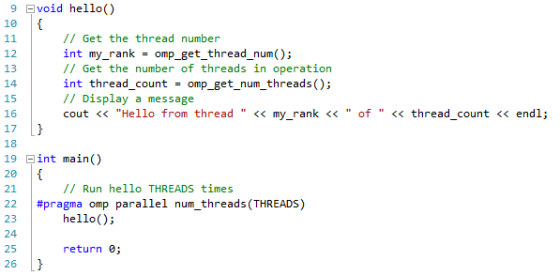
Simple OpenMP Application

Slide 12
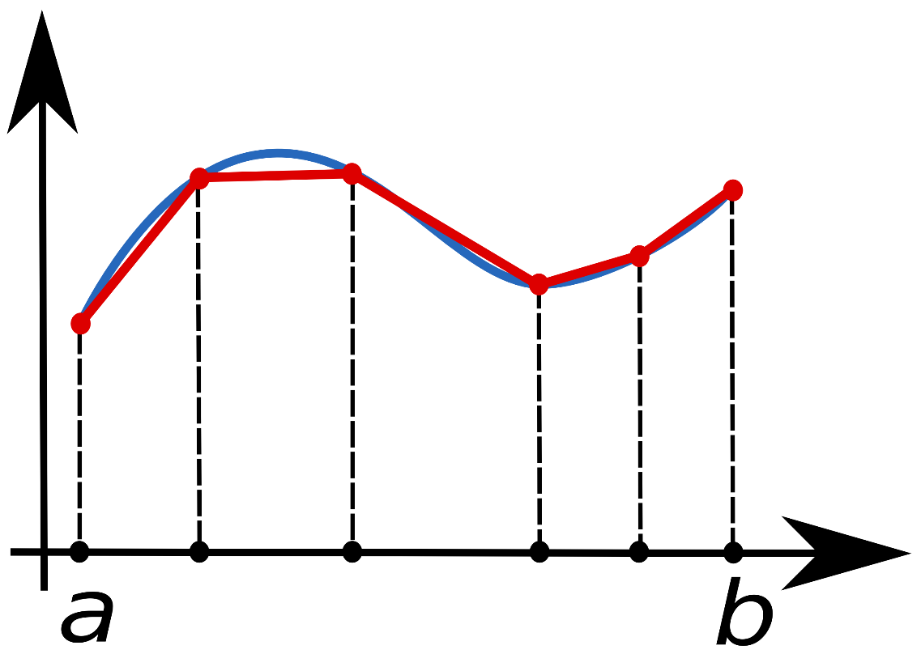
Example – Trapezoidal Rule
Lets look at a simple example – estimating the area under a curve
The right shows the trick we are going to use
Get two points on the curve
Get the area of the trapezoid formed by those two points
Add trapezoids together for range of the curve

Slide 13
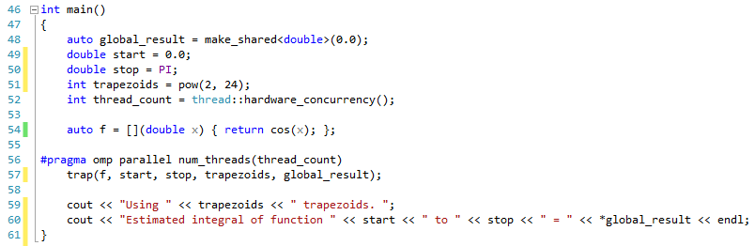
Running the trap Algorithm in OpenMP

Slide 14
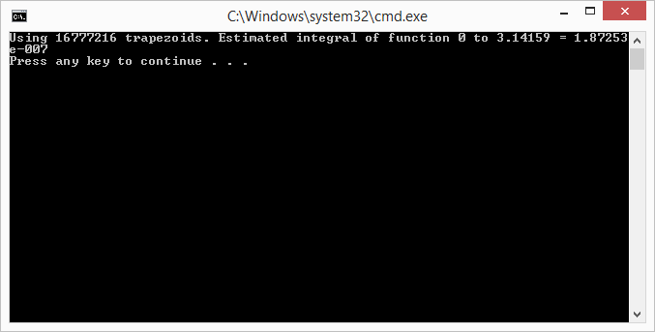
Results

Slide 15
Working with Variables

Slide 16
Scope
Now that we have lost the notion of threads we need to start being careful with our shared memory
OpenMP provides a number of methods to deal with variables
Scope of the variable
Reduction
For scope we are concerned with how a variable is shared between threads
i.e. should each thread have a unique value, can it be shared
Scope becomes really important in parallel for loops
Coming very soon

Slide 17
Examples
We can declare certain values as private or shared in our OpenMP pre-processor statement
private(variable)
A private copy is created for each thread
shared(variable)
Each thread can happily share the variable
By default, OpenMP will assign a scope for us – but it will likely be wrong
Good practise is to ensure we must define the scope
default(none)

Slide 18
Reduction Clause
Another method when dealing with variables is that we just want to use them to calculate a value at the end of the threads
For example, in multithreading we could start up n threads
Join the threads
Get the data
Perform calculation on the data
OpenMP supports this using a reduction clause
We will look at map-reduce as a pattern with MPI

Slide 19
Examples
For example, say each thread has at the end of it the following:
pi += result
We can state that this is a reduction variable by using the following in our OpenMP statement
reduction(+: pi)
Any standard C based operator can be used
+, -, *, &, |, ^, &&, ||
Be careful – minus is non-communative
A mixture of private and shared values achieve the reduction effect

Slide 20
Parallel For

Slide 21
Design Pattern
OpenMP can work fine with methods and we can easily parallelise applications using this technique
However, another observation is that we are generally working on a number of iterations and the work is based on an index
What we need is a method to create threads based on an index and split the work amongst the available threads
Data parallel problem
Think of an array – we want to work on an individual value per thread

Slide 22
How a Parallel For Works
Parallel for divides work up across the threads evenly
Thread 1 gets the first chunk
Thread 2 the second
etc.
Each chunk is of an equal size
Iterations / number of threads

Slide 23
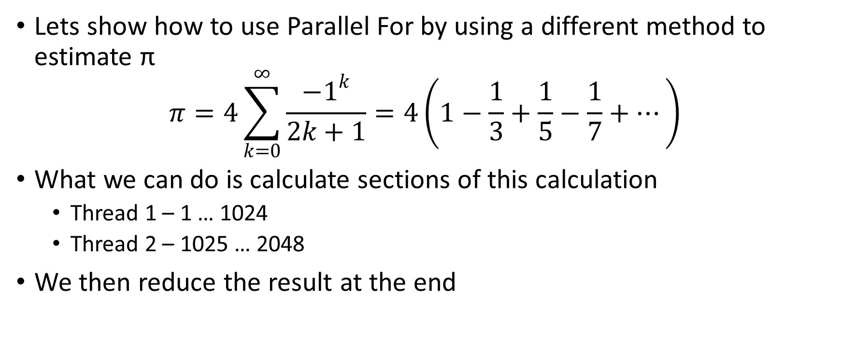
Estimating π
Lets show how to use Parallel For by using a different method to estimate π
$$π=4\sum_{k=0}^{∞}{\frac{{−1}^{k}}{2k+1}}=4\left(1−\frac{1}{3}+\frac{1}{5}−\frac{1}{7}+…\right)$$
What we can do is calculate sections of this calculation
Thread 1 – 1 … 1024
Thread 2 – 1025 … 2048
We then reduce the result at the end

Slide 24
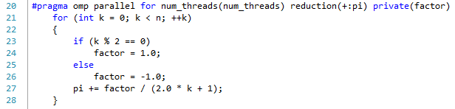
Parallel For Example

Slide 25
Dividing Work

Slide 26
Dividing Work
OpenMP by default will divide work into even chunks
Although many problems can be divided in this manner not all of them do
We need a method to tell OpenMP how to divide the work up amongst the threads
To do this we can use the schedule clause
schedule(type [, chunksize])
This provides more flexibility
Mandelbrot is a good one to test this with

Slide 27
Scheduling
Depending on the scheduling work is divided in different manners
For example we can
Have the work interleaved (see below)
Let OpenMP decide
Dynamic – based on what work needs to be done and threads available

Slide 28
Scheduling Types
There are four scheduling types
schedule(static, chunksize)
Each thread is given chunksize iteration blocks.
schedule(static, 2) would mean
Thread 1 – 1, 2, 5, 6, 9, 10, …
Thread 2 – 3, 4, 7, 8, 11, 12, …
schedule(dynamic)
Assigned to the threads as the loop is executing – threads request work
schedule(auto)
Compiler / run-time system decides
schedule(runtime)
Determined at runtime (not by the run-time)

Slide 29
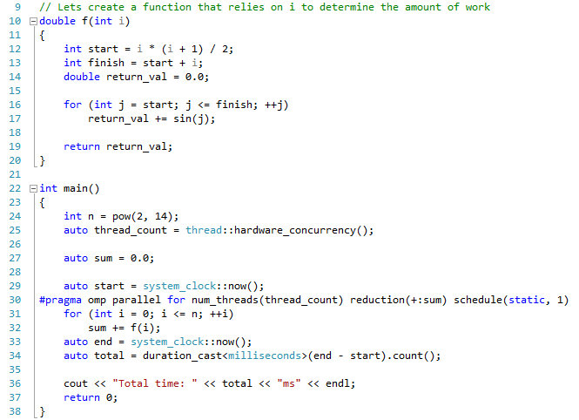
Scheduling Example

Slide 30
Other Useful OpenMP Functions

Slide 31
Atomics
OpenMP has some basic methods we discussed in multithreading
Atomic operations are possible with simple types
We use
#pragma omp atomic
The template for this operation is
x <op>= expression
Only simple operators work (+, -, etc.)
This is very basic – not as sophisticated as the low level C++ approach

Slide 32
Critical Sections
We can also declare critical sections in OpenMP
#pragma omp critical
Critical sections can be named to allow thread groups to work independently
OpenMP also supports nested locks
See the course text – this requires the use of lock objects
The same rules apply when thinking about locking – a critical section is just a mutex protected piece of code
Another interesting OpenMP function is the barrier – see the course text

Slide 33
Summary
Our focus with OpenMP is really to look at a higher level framework for dealing with multithreading / concurrency
We could have used Intel TBB, etc.
The same general rules apply when using OpenMP for concurrency
What we have been doing is thinking in higher level design patterns
Parallel
Parallel For
Reductions
Read Chapter 5 of Introduction to Parallel Programming – there is a lot you can do with OpenMP

